Slide 1




Business Overview
By Initiative Gang Team

Slide 2



OUR BUSINESS MODEL
Key Activities
Value Propositions
Memberships
reminder and follow up reminder, quotes from the apps
offers in events and free sessions
high end people
a+ a b +
age from 16 till 70
Key Partners
Customer Relationship
Customer Segments
Therapy
Communication or social
coaching
yoga
workshops and event
Guiding, Healing and Transforming.
Elysium is a centre which would be concentrates on the customer and their experience from hearing, guiding them and trying to heal or overcome their traumas and how to transfrom their life for the better or the one they wanted.
schools
Universities
rehab centers
Companies
clubs
Hospitals
Orphanages
Elderly homes
Key Resources
website
Location
3 instructors
3 Therapist
fund raiser “ partners “
3 admins
1 doctor
social media and websites
booths
app
flyers awareness
Channels
1 million EGP
app
memberships
sessions
Sponsorships
Collaboration with small business and startup
Cost Structure
Revenue Stream

Slide 3


ABOUT US
our name came from the greek god who was related to the mind and the well- being
and thats we will work on here in elusiim and thats why we are here that we will be concentrating on the mental health, well-being and how to develop and improve your life in general.
elusium is a place where you feel like home and safe, its a place to transform your life in a very healthy way as we do have the expertise in well-being from Greek.
we studied greek way of thinking, healing and the way how transform their lives to be better and thats why we are here!

Slide 4
OUR VALUE
Innovative treatment methods such as cognitive behavioral therapy (CBT) or art and music therapy
Online therapy sessions, or interactive content that raises psychological awareness
“We provide innovative psychotherapy solutions, delivered by specialized clinicians in a safe and confidential atmosphere, with personalized treatment programs for individuals suffering from anxiety, stress and daily pressures. We aim to enhance the client’s psychological and physical well-being through ongoing support and multiple resources that provide stability and psychological growth.”

Slide 5

SWOT
WEAKNESS
STRENGTHS
Diverse Services
Brand Name and Culture
Collaboration
Staff
Service Innovation
High Operating Cost
High Reliance on Partnership
Technological Challenges
OPPURTINITES
THREATS
Increase Awereness About Mental Health
Strategic Partnership
High Competition
Economic Changes
Legislative Challeges
Stigma Associated With Mental Hea

Slide 6


OBJECTIVE
S
Increase brand awareness by 25% within the 1st Q through targeted social media campaigns and community outreach initiatives.
Achieve a 90% client satisfaction rate by consistently delivering high-quality, personalized services.
Working on word of mouth marketing
Guerrilla Marketing through fashion brands and places .
M
Track website traffic, social media engagement, and media mentions to measure brand awareness.
Gather client feedback through surveys, reviews, and one-on-one conversations to assess satisfaction levels.
Monitor the number of new clients enrolled in specialized programs .

Slide 7
OBJECTIVE
A
Allocate a dedicated budget for targeted social media advertising and community engagement activities. (90K) 1st Q
on social media such as IG and snapchat
on ground, we achieve it through printing and giveaway (60k) 1st Q
R
Focusing on brand awareness will attract new clients and establish #Elysuiim as a trusted provider of mental health and wellness services.
Prioritizing client satisfactionwill ensure that clients have a positive experience and are likely to return for future services and recommend the center to others.
T
Increase brand awareness by 25% within the 1st Q through targeted social media campaigns and community outreach initiatives.
Achieve a 90% client satisfaction rate by consistently delivering high-quality, personalized services by End of the year 24

Slide 8


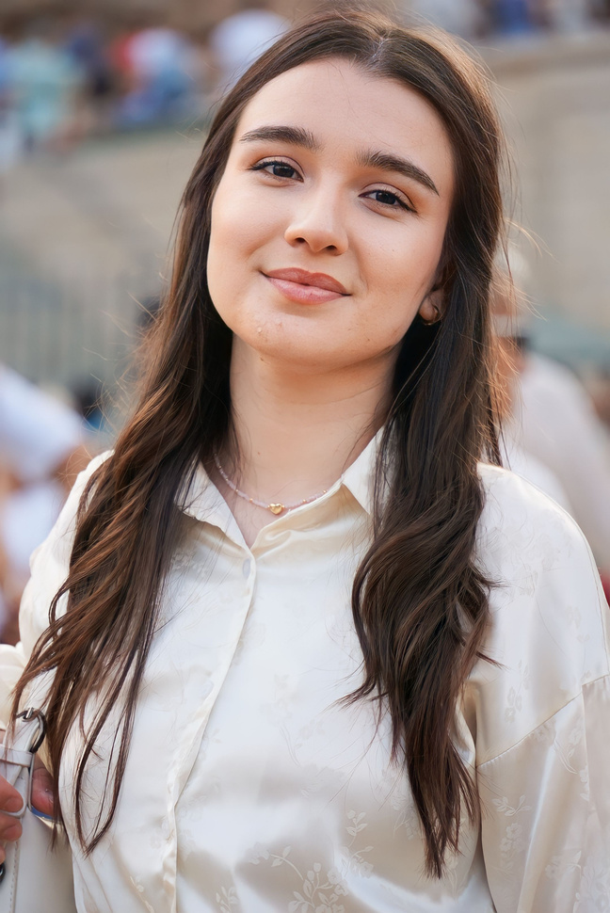

Feminine
BAYER PERSONA
Married
Pain or problems:
Her schedule is busy with work and personal life, so she is looking for efficient and fast services
Office manager
Work pressure
Tone of communication with her:
Friendly, youthful, and interactive.
It is preferable to focus on luxury, comfort and high quality.
Use photos and videos in communication to highlight the service experience
Future anxiety
35
years old
Mariam
What you need from Elysium Center:
Distinctive massage and relaxation sessions.
MAHER
Motivations:
You need centers that provide a luxurious experience and feel rejuvenating.
Prefer exclusive offers and personal attention.
Values ​​innovation in products and services.
Objectives:
She seeks to maintain her natural beauty, and cares about skin care.
Looking for relaxation and energy renewal.
Seeks to experience high-quality services in the field of personal care
Hobbies and interests:
Interested in health and personal care.
Follow fashion and beauty updates.

Slide 9

STRATEGY
Target Market
Our Target market includes individuals and groups seeking mental health services
and support with in great Cairo
Individuals experiencing mental health challenges (anxiety, depression, trauma, etc.).
Families and loved ones of individuals with mental health conditions.
Businesses interested in employee wellness programs.

Slide 10
STRATEGY
Segmentation
The segmentation analysis based on
Demographic
psycho graphic
and behavioral

Slide 11
STRATEGY
Demographic
Population size
Cairo: 10,333,378 person excluding Expats
Age Intervals
15 - 39 and 40- 64 as they represent 40% and 22% of total population
Gender Type
Both male and female as they are almost the same percentage to total population 48% 52% in Cairo respectively
Social Marital Status
An increasing rate of divorce and decreasing rate in Marriage
Divorce rate : 1.9% 2010 to 2.8 % and it reached 3.5% in Urban area compared to 1.9 in rural area and Marriage: 11% 2010 to 9% 2022

Slide 12
STRATEGY
Application in Elysium
High School Students
Academic pressure, peer relationships, and identity issues.
Adolescents
(15-17 years)
Adults (18-65 years)
lParents
lYoung Professionals
lMiddle-aged Adults
Elderly (65+ years)
lRetirees
lElderly with Chronic Conditions
Location
Great Cairo resident including Expats

Slide 13
STRATEGY
Psychographic
Lifestyle
Active Life style
Busy Professionals
Family-Oriented
Personality Traits
Introverted Individuals
Extroverted Individuals
Ambitious and High-Achievers
Values
Personal Growth and Development
Health and Wellness
Support and Community
Interests and Hobbies
Mindfulness and Meditation
Art and Creativity
Fitness and Physical Health

Slide 14
STRATEGY
Application in Elysium
Customized Communication Content Marketing
posts, videos, social media content addresses specific psychographic traits as stress management techniques for busy professionals
Email Campaigns
egment email lists based on psychographic profiles
Community Engagement
Workshops and Seminars: like personal growth, stress management, and mindfulness
Support Groups: for different segments, such as parents, young professionals, and retirees
Marketing Channels
lSocial Media: platforms like Instagram and LinkedIn to reach different psychographic segments
Local Community Events: Participate in local health fairs and community events
Partnerships Collaborations
Partner with gyms, yoga studios, and wellness centers
Corporate Programs
partnerships with businesses to offer employee assistance

Slide 15
STRATEGY
Behavioral
Frequency of Service Use
lRegular Users
lOccasional Users
lFirst Time Users
Service Type Preference
lIndividual therapy
lGroup Therapy
lSpecialized programs
Engagement Level
Highly Engaged
Moderately Engaged
Low Engagement
Benefits Sought
lEmotional Support
lSkill Development
lCrisis Intervention
Preventive Care

Slide 16
STRATEGY
Application in Elysium
Tailored Communication
Create targeted messaging for each behavioral segment ex:use empathetic language and highlight emotional support for clients seeking crisis intervention
Flexible Payment Options
insurance coverage, self-pay options, and financial assistance programs to accommodate different paymenex:value, Premium
Educational Content
Share articles, webinars, and workshops on stress management for young professionals, parenting support for parents, and coping strategies for those in crisis
Customized Services
Offer packages for regular users, introduce introductory sessions for first-time users, and provide specialized programs for those seeking particular types of therapy

Slide 17
STRATEGY
Positioning
Our mental health center in NewCairo is dedicated to providing compassionate, high-quality mental health services tailored to meet the diverse needs of our community in Cairo using the best techniques applied in the best mental health centers in Greece. We offer a safe, inclusive, and supportive environment where individuals and families can find the care and resources they need to thrive. We offer experts from Greece on regular basis.

Slide 18
STRATEGY
Key Elements of Positioning
Compassionate and Inclusive Care:Emphasize a welcoming and non-judgmental atmosphere for all clients
High-Quality Professional Services: the best care applying techniques from Greece.
Accessibility and Convenience:Offer flexible scheduling to accommodate the busy lifestyles of young professionals and parents and relocation for workshops and group therapy too.
Holistic and Personalized Approach:Provide personalized treatment plans
Community Engagement and Support:Position the center as an integral part of the New Cairo community
Tagline: “ Your Path to Mental Well-Being “

Slide 19

1. Objectives
ACTION PLAN
2.Tasks or Activities
7- Risks & Challenges
6.KPIs
3. Responsibilities
5. Resources Required
4. Timeline

Slide 20
1. OBJECTIVES
Increased the number of followers on social media pages by 30% within two months.
Achieving an engagement rate of up to 5% through promotional campaigns on digital platforms.
Reaching 50,000 people within the first month of launching the campaign.

Slide 21
2.TASKS OR ACTIVITIES
Task 1: Define the target audience
Content: Research and analyze the appropriate audience (age group, geographic location, interests).
Responsible: Marwa (data analyst)
Objective: Identify the potential customer segment to ensure the campaign is directed to the right audience.
Implementation date: October 1 - October 3, 2024.
Task 2: Create the right content
Content: Designing publications about mental health (psychological advice, information about sessions, introductory videos about the center).
Responsible: Ziad (designer), Sarah (content writing).
Objective: Building attractive and useful content that enhances trust between the center and the audience.
Implementation date: October 4 - October 10, 2024.
Task 3: Produce an introductory video about the center
Content: A minute-long video showing the available services and benefits provided by the center.
Responsible: Abdullah (production and photography), Sarah (script writing).
Objective: To provide a comprehensive picture of the center to enhance awareness among the public.
Implementation date: October 7 - October 12, 2024.

Slide 22
2.TASKS OR ACTIVITIES
Task 4: Manage paid advertising campaigns
Content: Paid ads on Facebook and Instagram targeting the specific audience.
Responsible: Marwa (campaign management), Ziad (advertising design).
The goal: attract the largest number of followers and potential customers.
Implementation date: October 13 - October 30, 2024.
Task 5: Launch the campaign on social media
Content: Publish content (posts, videos, ads) regularly.
Administrator: Abdullah (scheduling posts), Sarah (responding to comments).
Goal: Publish content and increase daily interaction with the audience.
Implementation date: October 15 - November 15, 2024
Task 6: Analyze performance and review results
Content: Analysis of performance indicators (visits, interaction, conversions).
Responsible: Marwa (results analysis), Abdullah (performance report).
Objective: Review performance and identify possible improvements.
Implementation date: November 16 - November 20, 2024.

Slide 23
3. RESPONSIBILITIES
Marwa (Project management) :
Managing the entire project.
Coordinating with the team and overseeing task execution.
Managing paid campaigns and analyzing results.
Ziad (Designer):
Designing social media posts.
Creating visual ads.
Collaborating on the production of the introductory video.
Abdullah (Photographer and Editor):
Filming and producing the introductory video.
Scheduling and publishing content.
Preparing performance reports and analyzing key success metrics.
Sarah (Content Writer):
Writing content for social media posts.
Drafting scripts for the introductory video and advertisements.
Engaging with the audience and responding to comments and messages.

Slide 24
4. TIMELINE
Week 1: Identify the audience and create content.
week 2:
start of the campaign
Week 3 / 4:
monitoring performance and analyzing results.

Slide 25
5. RESOURCES REQUIRED
Human resources
1-Psychotherapists
2-Financial
3-management
An integrated
4-digital marketing
5-team
Customer support team
Financial resources
1-Operating costs
2-Marketing costs
Technical resources
1-Computers
2-CRM platform
3-Electronic payment platform

Slide 26
6.KPIS
Identify measurement tools: Use tools like spreadsheets or project management software (such as Trello, Asana or Monday.com) to track task progress. Dedicate a column to the weekly KPIs for each team or task.
To know the number of followers - the extent of interaction with publications - the number of customers who responded and actually participated in the center’s sessions

Slide 27
7- RISKS & CHALLENGES
Identify risks on the one hand
Failure to achieve the target customer reach rate
Difficulty achieving value
Strong competition with competitors
The cost of sessions is expensive

Slide 28
SITUATION
ANALYSIS
Internal Factors
External Factors
Staff and staff training
Resources
Internal Policies
Staff Support
Government Regulations
Community Support
Economic Conditions
Technologies

Slide 29
7 P
S
The 7 Ps are 7 matrices which include “Product, Place, price, Promotions, People, Process, Physical Evidence “which are essential for effective marketing, showcasing services, ensuring customer satisfaction, and building a strong relationship with clients and other business

Slide 30
7 P
S
Product
Places
Price
People
Process
Mental Health for therapy, coaching, education, and other activities for mindfulness through different kinds of events and workshops. Also with variety of membership
Duplex apartment with garden or a villa in 5th settlement.
With a garden and simple decoration, it would be relaxing for the eyes with fresh air.
Online website and page whcih would include soem information about the center and the plans for memeberships
When it comes to the price, we do have differences if the client would need one session or multiple sessions or membership.
1 session for 1k and he can apply for financial aid and will get 40% off
Multiple sessions like 6 a month which is 2 a week will be 4.5 k.
If the customer through another customer both will get 10 % off
Well-educated doctors and therapists with experience so they can deal with all client's issues effectively.
Training all the staff and educating them on how they will treat our clients guide them correctly and be nice to them so they will feel that they are engaged with Elysium
Our focus will be on the customer experience and how they feel while they are at Elysuim, they should feel as if they are at home with the most professional treatment and premium experience through management and experienced customer service
Easy access and understanding of online experience
Also concentrating customer loyalty by sending follow-up msg and checking up on them
Physical Evidence
Our visuals will be consistent with green and beige which are the colours which represent the brand, our centre and also represent peacefulness.
The website will be easy to deal with logo colours and easy to schedule an appointment, and also there will be a review section as we care about the customers' opinion to develop our centre.

Slide 31
PROMOTION
Annual promotional plan for our start-up center
Quarter 1: Foundation & Awareness
Quarter 2: Engagement & Growth
Quarter 3: consolidation & Expansion
Quarter 4: Review and innovation

Slide 32
DEFINE YOUR KEY MESSAGE

Slide 33
DEFINE YOUR KEY MESSAGE
Our permanent mission is a society that does not suffer. Therefore, we seek to train individuals to recognize the signs of psychological problems in themselves and in others
Awareness of mental health by enhancing social communication and community participation

Slide 34
KEY WORDS
Mental health & psychological support
Emotional support
Psychological fatigue
Yoga
Depression
Suicide
Adolescence
Meditation
Misunderstanding
Anxiety
Stress control
Boredom
Lack of self-confidence
Autism
Addiction
Mind full of though
Difficulty in learning
Social phobia
Bipolar disorder
Post-traumatic stress disorder “ PTSD “
Neurodivergent
Eating disorder

Slide 35
KPIS
BRAND AWARENESS KPIS:
Reach ratio:
In July, 50,000 people were reached via social media platforms (Facebook, Instagram).
Number of impressions:
The total number of impressions was 120,000 across various channels during the same period, which means the audience saw the content multiple times.
Follower Growth:
At the end of July, 2,000 new followers were added on Instagram, indicating an increase in brand awareness.

Slide 36
KPIS
ENGAGEMENT KPIS
Engagement rate:
The engagement rate was 5%, measuring 6,000 interactions (likes, comments, shares) out of a total of 120,000 impressions.
Number of comments and shares:
During the month, 400 comments and 200 shares were recorded on the posts, indicating strong engagement with the content.
Video viewing duration:
5 videos were published about mental health, and the average viewing duration for each video was 30 seconds out of a 1-minute video, which reflects a good viewership rate.

Slide 37
KPIS
KPIS FOR TRUST AND BUILDING RELATIONSHIPS
Number of direct messages:
The center's account received 150 private messages inquiring about treatment sessions and available services, which reflects interest from the public in interacting with the center.
Conversion Rate:
Out of 150 messages, 30 people booked an actual counseling session, which means a conversion rate of 20%.

Slide 38
KPIS
SALES & CONVERSIONS KPIS:
Number of Bookings:
During the month, 60 bookings were recorded for counseling sessions, most of which were the result of social media advertising campaigns.
Total Revenue:
The revenues generated from these sessions amounted to 30,000 Egyptian pounds, with an average of 500 pounds per session.

Slide 39
KPIS
TRUST & CREDIBILITY KPIS:
Customer Reviews:
The center received 50 reviews via Google and Facebook, with an average rating of 4.8 out of 5, reflecting customer satisfaction with the service.
Customer Retention Rate:
Of the 60 clients who booked a session, 15 clients returned to book additional sessions, indicating a client retention rate of 25%.

Slide 40
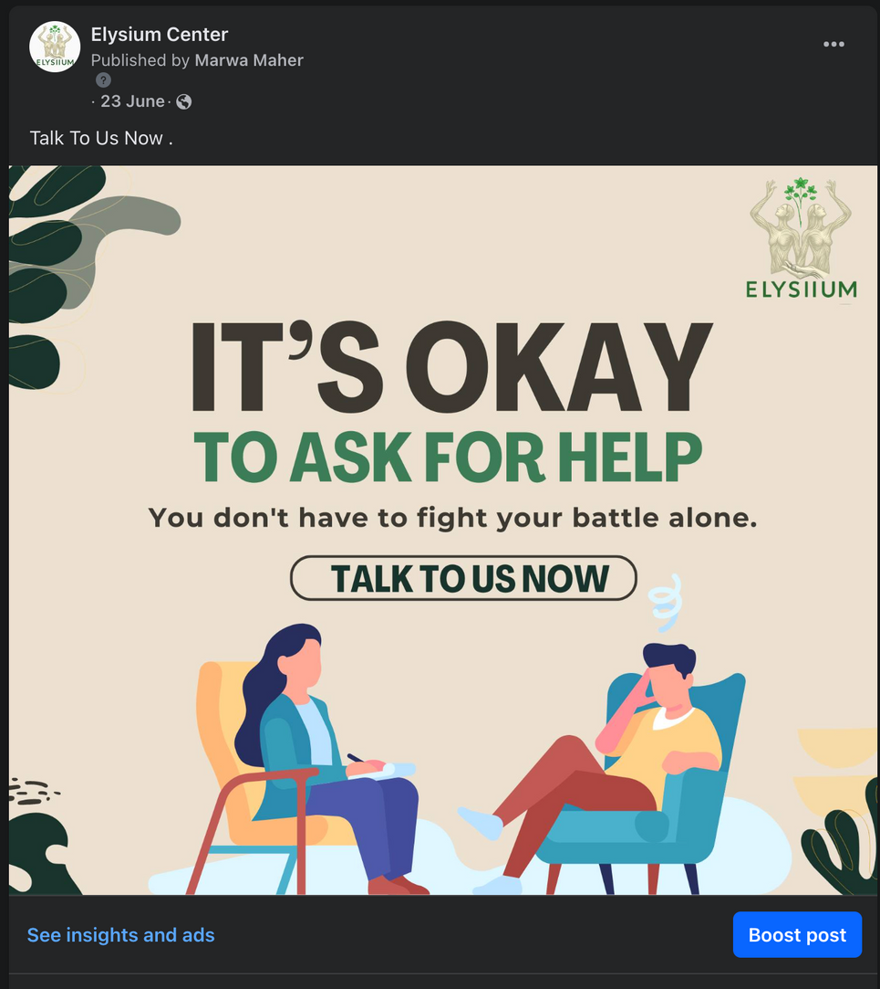
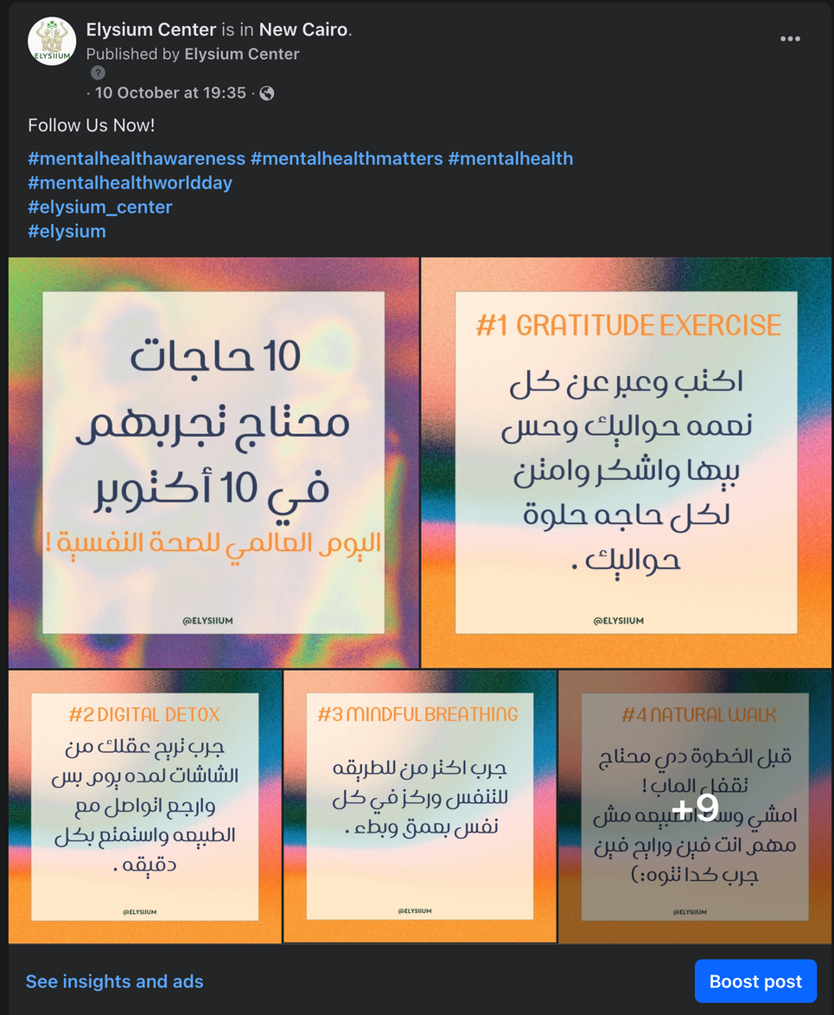

Slide 41
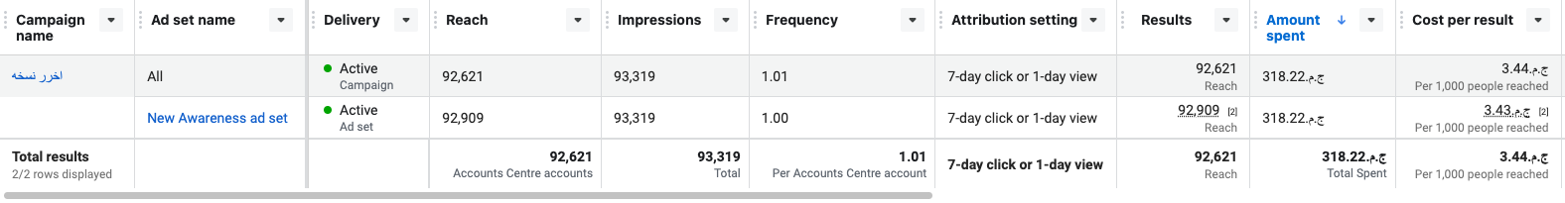

Slide 42
RECOMMENDATIONS TO IMPROVE
Enhance Digital Skills:
Implement training workshops focused on digital skills, such as digital marketing, content management, and data analysis.
Utilize online learning platforms to equip employees with up-to-date knowledge of modern technologies.
Digitize Internal Processes:
Digitize daily operations to streamline work and boost productivity by using digital project management tools like Trello or Asana.
Provide easy access to data and information through shared platforms like Google Workspace or Microsoft 365.

Slide 43
RECOMMENDATIONS TO IMPROVE
Foster Digital Innovation:
Create internal platforms where employees can present new digital ideas and encourage innovation.
Motivate employees to leverage technological tools to improve daily tasks and enhance operational efficiency.
Ehance Internal Communication:
Use instant communication apps like Slack or Microsoft Teams to facilitate team collaboration and increase efficiency.
Hold regular virtual meetings to save time and improve effective communication.

Slide 44


Slide 45

Powered by: Dr. Tamer

